Slide 1
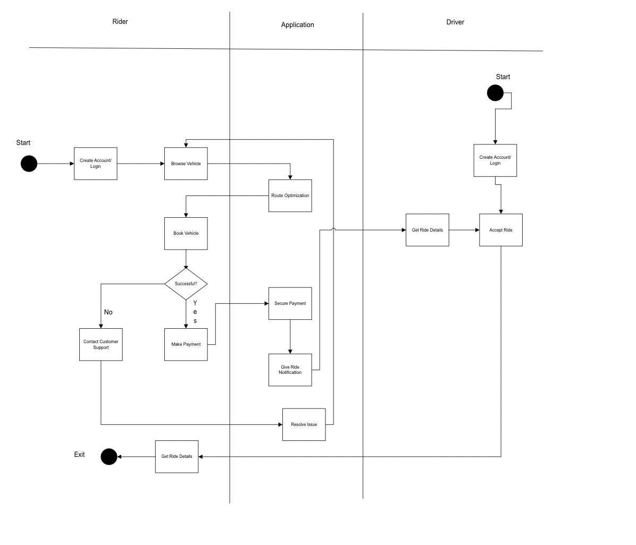
RideEase Activity Diagram

